Slide 1
VaultofCodes TASK__2 TOPIC:PPT_on_function_module_and_data_manipulation_in_python

Slide 2
PYTHON PROGRAMMING: ENHANCING EFFICIENCY THROUGH FUNCTIONS, MODULES, AND DATA MANIPULATION

Slide 3

INTRODUCTION
Python Programming is a powerful tool for enhancing eficiency in data manipulation. This presentation will cover the use of Functions and Modules to streamline code, as well as techniques for Data Manipulation to make the most of your data. Join us on this journey to become a more eficient Python programmer!

Slide 4
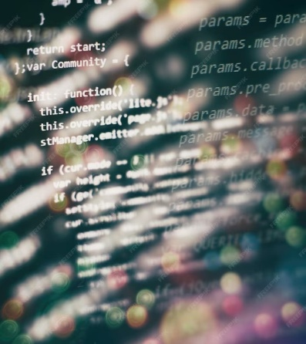
FUNCTIONS
Functions are a key tool for enhancing eficiency in Python programming. By breaking code into reusable chunks, we can simplify complex tasks and minimize repetition. In this section, we will cover how to deﬁne and use functions in Python.

Slide 5

MODULES
Modules are a powerful way to organize code and make it more reusable. By grouping related functions and variables together, we can create self-contained packages that can be easily shared and used by others. In this section, we will cover how to create and use modules in Python.

Slide 6

DATA MANIPULATION
Data Manipulation is a critical skill for any Python programmer working with large datasets. By using techniques such as ﬁltering, sorting, and aggregation, we can quickly extract insights and make informed decisions. In this section, we will cover some of the most common techniques for manipulating data in Python.

Slide 7
CONCLUSION
Python programming is a powerful tool for enhancing eficiency in data manipulation. By using functions, modules, and data manipulation techniques, we can streamline our code and extract insights from even the largest datasets. Thank you for joining us on this journey to become more eficient Python programmers!

Slide 8
Thank you!!!

